Slide 1
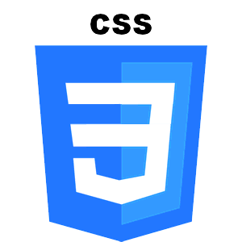
CSS

Slide 2
CSS
CSS (which stands for Cascading Style Sheets) is a style sheet language used to describe the appearance and formatting of your HTML.
Style sheets are cascading because the sheets can apply formatting when more than one style applies
You can apply similar appearance and formatting to several HTML pages from a single CSS file

Slide 3
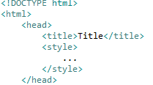
There are two ways to put CSS in one place.
First:
Put your CSS between <style></style> tags inside the <head></head> of your webpage, right in the same file as your HTML.

Slide 4
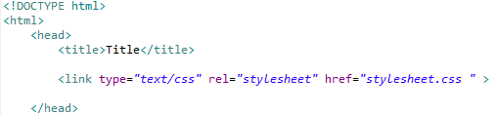
Second:
Write your CSS in a totally separate file.
Put a <link> tag between the <head></head> tags of your HTML page.

Slide 5
Syntax
selector {
property: value;
}

Slide 6
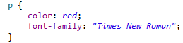
selectors
A selector can be any HTML element <p>, <img>, <table>.
A property is an aspect of a selector. (font-family, color, font-size).
A value is a possible setting for a property.
You need to end each property-value with a semi-colon (;).
you can set many properties for one selector.

Slide 7
Multiple Selectors
As you've seen, it's possible to nest HTML elements inside one another, like so:
So what if you want to grab <p>s that are inside two <div>s, and not all <p>s?
You select those in the CSS tab like this:
<div>
<div>
<p>I like tacos!</p>
div div p {
/*CSS stuff!*/
}

Slide 8
you can use the * selector to apply CSS styling to every element on the page.
* {
border: 2px solid black;
}

Slide 9
/*I'm a comment!*/
Color hexadecimal values.

Slide 10
Parents, children, and siblings
A child of an element, and all that child's children, are children of the first parent).

Slide 11
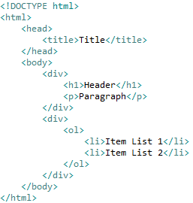
HTML
Parent
HEAD
Siblings
BODY
Children
TITLE
DIV
DIV
H1
P
OL
LI
LI

Slide 12
Dom (document object model)
HTML is an XML-like structure in that the elements form a structure of parents’ nodes with children, like the branches of a tree. There is one root element (html) with branches like head and body, each with their own branches. For this reason, the DOM is also called the DOM tree.

Slide 13
There are two important selectors you can use in addition to the universal selector and HTML elements: classes and IDs.

Slide 14
Class
Classes are useful when you have a bunch of elements that should all receive the same styling.
Rather than applying the same rules to several selectors, you apply the same class to all those HTML elements.
Classes are identified in CSS with a dot (.)

Slide 15
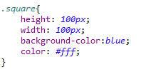
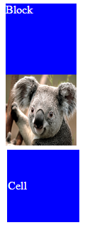
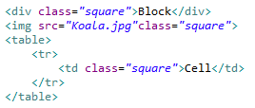

Slide 16
IDs are great for when you have exactly one element that should receive a certain kind of styling.
id should be unique within a page
IDs are identified in CSS with a pound sign (#):

Slide 17
pseudo-class selectors.
A pseudo-class selector is a way of accessing HTML items that aren't part of the document tree.
For example, we could change a link's text-decoration property to make it something other than blue and underlined. Using pseudo selectors, you can control the appearance of unvisited and visited links—even links the user is hovering over but hasn't clicked.
The CSS syntax for pseudo selectors is
selector:pseudo-class_selector {
property: value;
}
It's just that little extra colon (:).

Slide 18
Links
There are a number of useful pseudo-class selectors for links, including:
a:link: An unvisited link.
a:visited: A visited link.
a:hover: A link you're hovering your mouse over.

Slide 19
First child
Another useful pseudo-class selector is first-child. It's used to apply styling to only the elements that are the first children of their parents. For instance:
p:first-child {
color: red;
}
Would make all paragraphs that are the first children of their parent elements red.

Slide 20
Units (font-size)
http://kyleschaeffer.com/development/css-font-size-em-vs-px-vs-pt-vs/
Ems (em): The “em” is a scalable unit that is used in web document media. An em is equal to the current font-size, for instance, if the font-size of the document is 12pt, 1em is equal to 12pt. Ems are scalable, so 2em would equal 24pt, .5em would equal 6pt, etc. Are Mobile-device-friendly.
Pixels (px): Pixels are fixed-size units that are used in screen. One pixel is equal to one dot on the computer screen. One problem with the pixel unit is that it does not scale upward for visually-impaired readers or downward to fit mobile devices.

Slide 21
Points (pt): Traditionally used in print. One point is equal to 1/72 of an inch. Points are much like pixels, in that they are fixed-size units and cannot scale in size.
Percent (%): The percent unit is much like the “em” unit, save for a few fundamental differences. First and foremost, the current font-size is equal to 100% (i.e. 12pt = 100%). While using the percent unit, your text remains fully scalable for mobile devices and for accessibility.

Slide 22
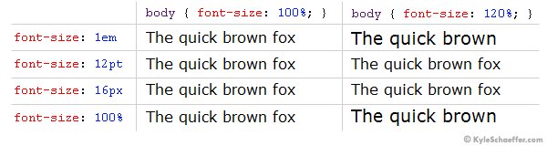
http://kyleschaeffer.com/development/css-font-size-em-vs-px-vs-pt-vs/

Slide 23
display property
There are many possible values but the main 4 are the following:
Block
Inline-block
Inline
None
Also
Flex, Table

Slide 24
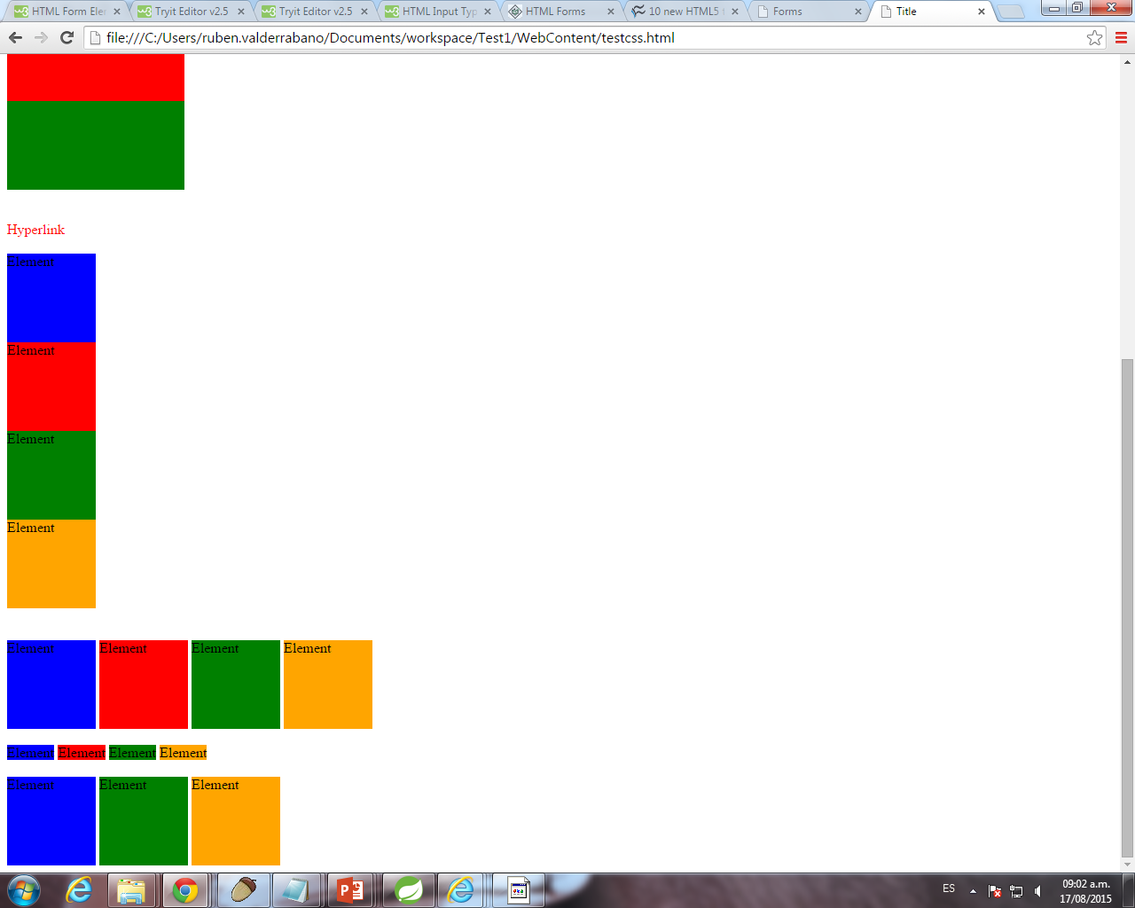
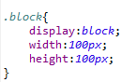
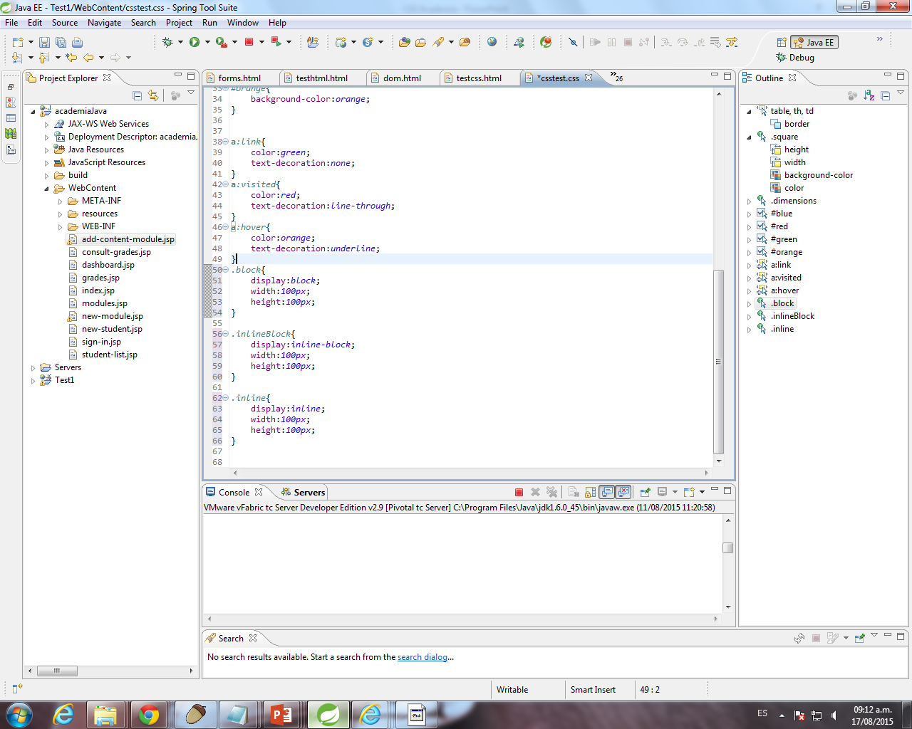
Block: This makes the element a block box. It won't let anything sit next to it on the page! It takes up the full width.
Inline-block: This makes the element a block box, but will allow other elements to sit next to it on the same line.

Slide 25
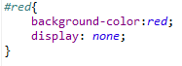
Inline: This makes the element sit on the same line as another element, but without formatting it like a block. It only takes up as much width as it needs (the smallest possible, not the whole line).
None: This makes the element and its content disappear from the page entirely!

Slide 26
Block-level Elements
A block-level element always starts on a new line and takes up the full width available (stretches out to the left and right as far as it can).
The <div> element is a block-level element.
Examples of block-level elements:
<div>
<h1> - <h6>
<p>
<form>

Slide 27
Inline Elements
An inline element does not start on a new line and only takes up as much width as necessary.
This is an inline <span> element inside a paragraph.
Examples of inline elements:
<span>
<a>
<img>

Slide 28
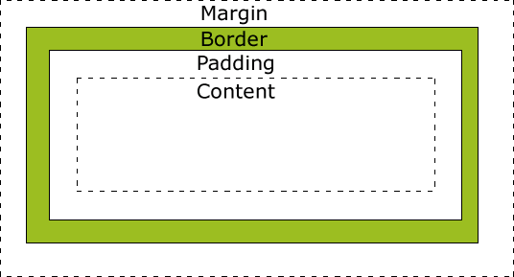
positioning.
Controlling the position of HTML elements allows you incredibly fine control over how your pages look.
Elements populate the page in what's known as the CSS box model. Each HTML element is like a tiny box or container that holds the pictures and text you specify.

Slide 29
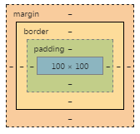
The margin is the space around the element. The larger the margin, the more space between our element and the elements around it. We can adjust the margin to move our HTML elements closer to or farther from each other.
The border is the edge of the element. It's what we've been making visible every time we set the border property.
The padding is the spacing between the content and the border. We can adjust this value with CSS to move the border closer to or farther from the content.
we can adjust the top, right, left, and bottom padding, border, and margin individually.

Slide 30
Adjusting our margins not only moves our element relative to other elements on the page, but also relative to the "walls" of the HTML document.
If we take an HTML element with a specific width (such as our <div> in the editor) and set its margin to auto, this tells the document to automatically put equal left and right margins on our element, centering it on the page.

Slide 31
If you want to specify a particular margin, you can do it like this:
margin-top: /*some value*/
margin-right: /*some value*/
margin-bottom: /*some value*/
margin-left: /*some-value*/
You can also set an element's margins all at once: you just start from the top margin and go around clockwise (going from top to right to bottom to left). For instance,
margin: 1px 2px 3px 4px;

Slide 32
The padding is the space between your border and your innermost layer: the actual content.
Padding can be set in two ways, just like your margins. You can either select them individually, like this:
padding-top: /*some value*/
padding-right: /*some value*/
padding-bottom: /*some value*/
padding-left: /*some-value*/
Or select them all in one declaration, like this:
padding: value value value value;

Slide 33
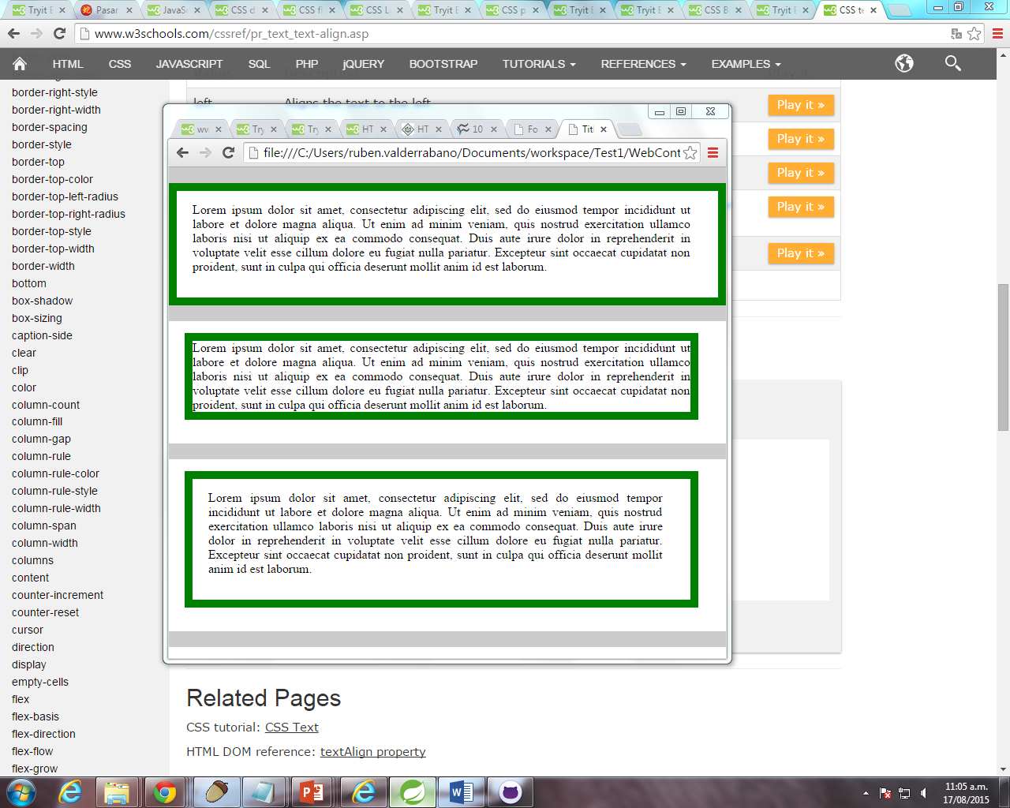
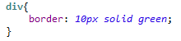
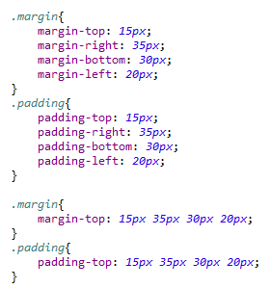
Padding
Margin
Margin and Padding

Slide 34
floats
When you float an element on the page, you're telling the webpage: "I'm about to tell you where to put this element, but you have to put it into the flow of other elements." This means that if you have several elements all floating, they all know the others are there and don't land on top of each other.
You can think of the HTML page as sort of like a sea, and floating elements as boats on it: all the boats have positions on the sea, and they all see and steer clear of each other.
Left – right – clear elemnts

Slide 35
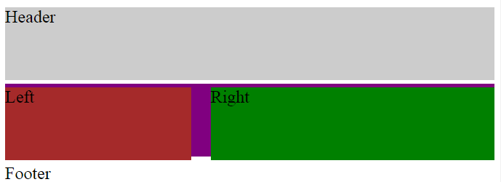
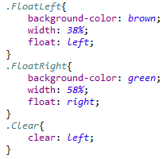
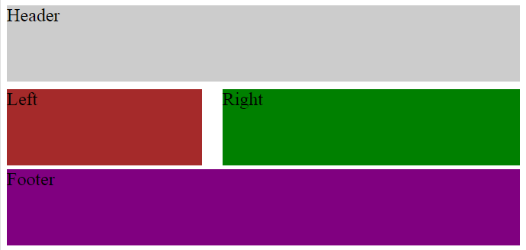
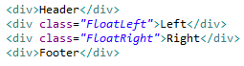
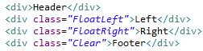

Slide 36
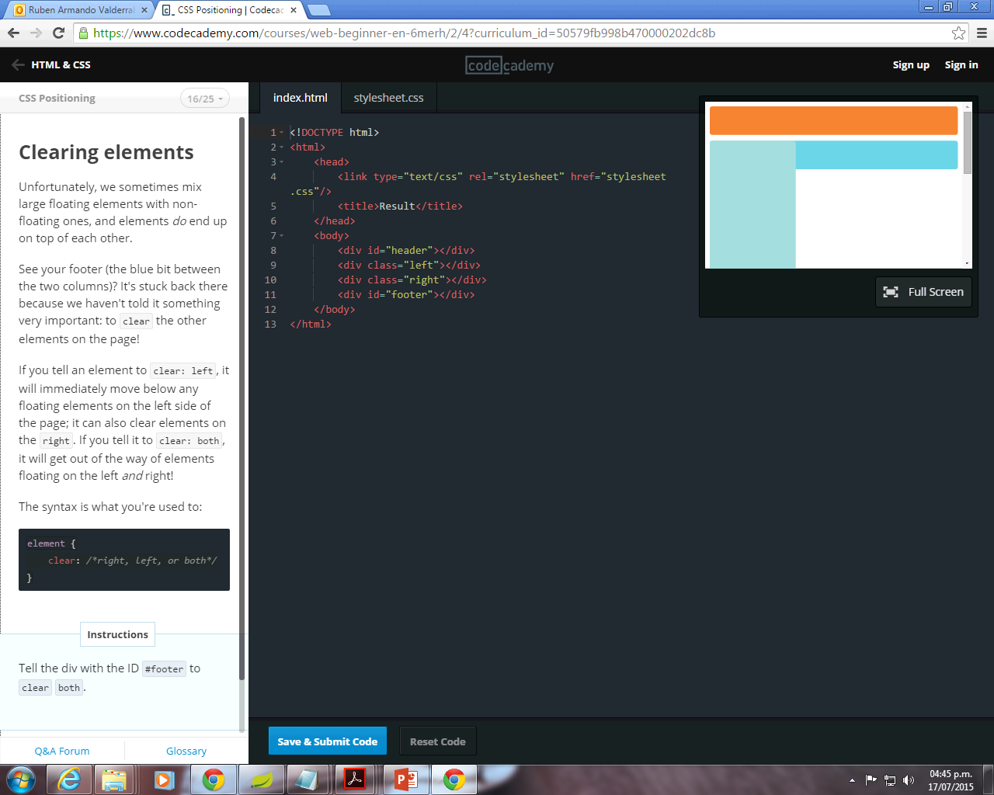
Unfortunately, we sometimes mix large floating elements with non-floating ones, and elements do end up on top of each other.
See your footer (the blue bit between the two columns)? It's stuck back there because we haven't told it something very important: to clear the other elements on the page!
The clear property is used to control the behavior of floating elements. Elements after a floating element will flow around it. To avoid this, use the clear property. The clear property specifies on which sides of an element floating elements are not allowed to float
If you tell an element to clear: left, it will immediately move below any floating elements on the left side of the page; it can also clear elements on the right. If you tell it to clear: both, it will get out of the way of elements floating on the left and right.
The syntax is what you're used to:
element {
clear: /*right, left, or both*/
}

Slide 37
Static , absolute, relative, fixed
If you don't specify an element's positioning type, it defaults to static. This just means "where the element would normally go." If you don't tell an element how to position itself, it just plunks itself down in the document.

Slide 38
Absolute positioning. When an element is set to position: absolute, it's then positioned in relation to the first parent element it has that doesn't have position: static. If there's no such element, the element with position: absolute gets positioned relative to <html>.

Slide 39
Relative positioning is more straightforward: it tells the element to move relative to where it would have landed if it just had the default static positioning.
If you give an element relative positioning and tell it to have a margin-top of 10px, it doesn't move down ten pixels from any particular thing—it moves down ten pixels from where it otherwise would have been.

Slide 40
fixed positioning anchors an element to the browser window—you can think of it as gluing the element to the screen. If you scroll up and down, the fixed element stays put even as other elements scroll past.

